Slide 1
Dev Tools with Swagger
Who needs a UI?

Slide 2
STORY TIME!
Notes:
Sitting next to Rick, coworker asks, our dbs are everywhere, how do I find all of our dbs for a given customer? Can we link all the servers?
Overheading I said, “Just make a little app.”
Long story short, I did.

Slide 3
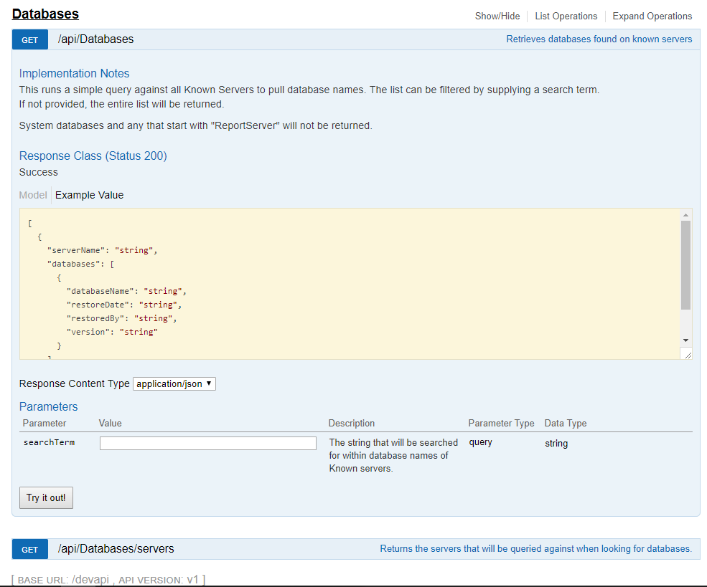
Notes:
Big win: I didn’t need to build a UI. Dev tool for Devs. They understand json and web apis.
So while I’m going over the basics (which is basically the readme from the github repo) start thinking about how you might utilize this for a problem you currently have.

Slide 4
But how do we do it Dave?!
I’m glad you asked. SUPER FAST DEMO TIME!

Slide 5

Dave van Herten
Twitter: @dvanherten
Github: @dvanherten
Blog: dave.vanherten.ca

